Slide 1


The Relationship Between Attendance and Unemployment & COVID-19 cases in TEXAS
Ye Seo Park

Slide 2

International Student. 🇰🇷
Curious about human behavior 🤔
During the COVID pandemic, I was a Master’s Student and couldn’t attend the classes due to the COVID infection. 🦠
COVID REALLY affected my life and even my research. (eg. languish) 🫠
I am …

Slide 3
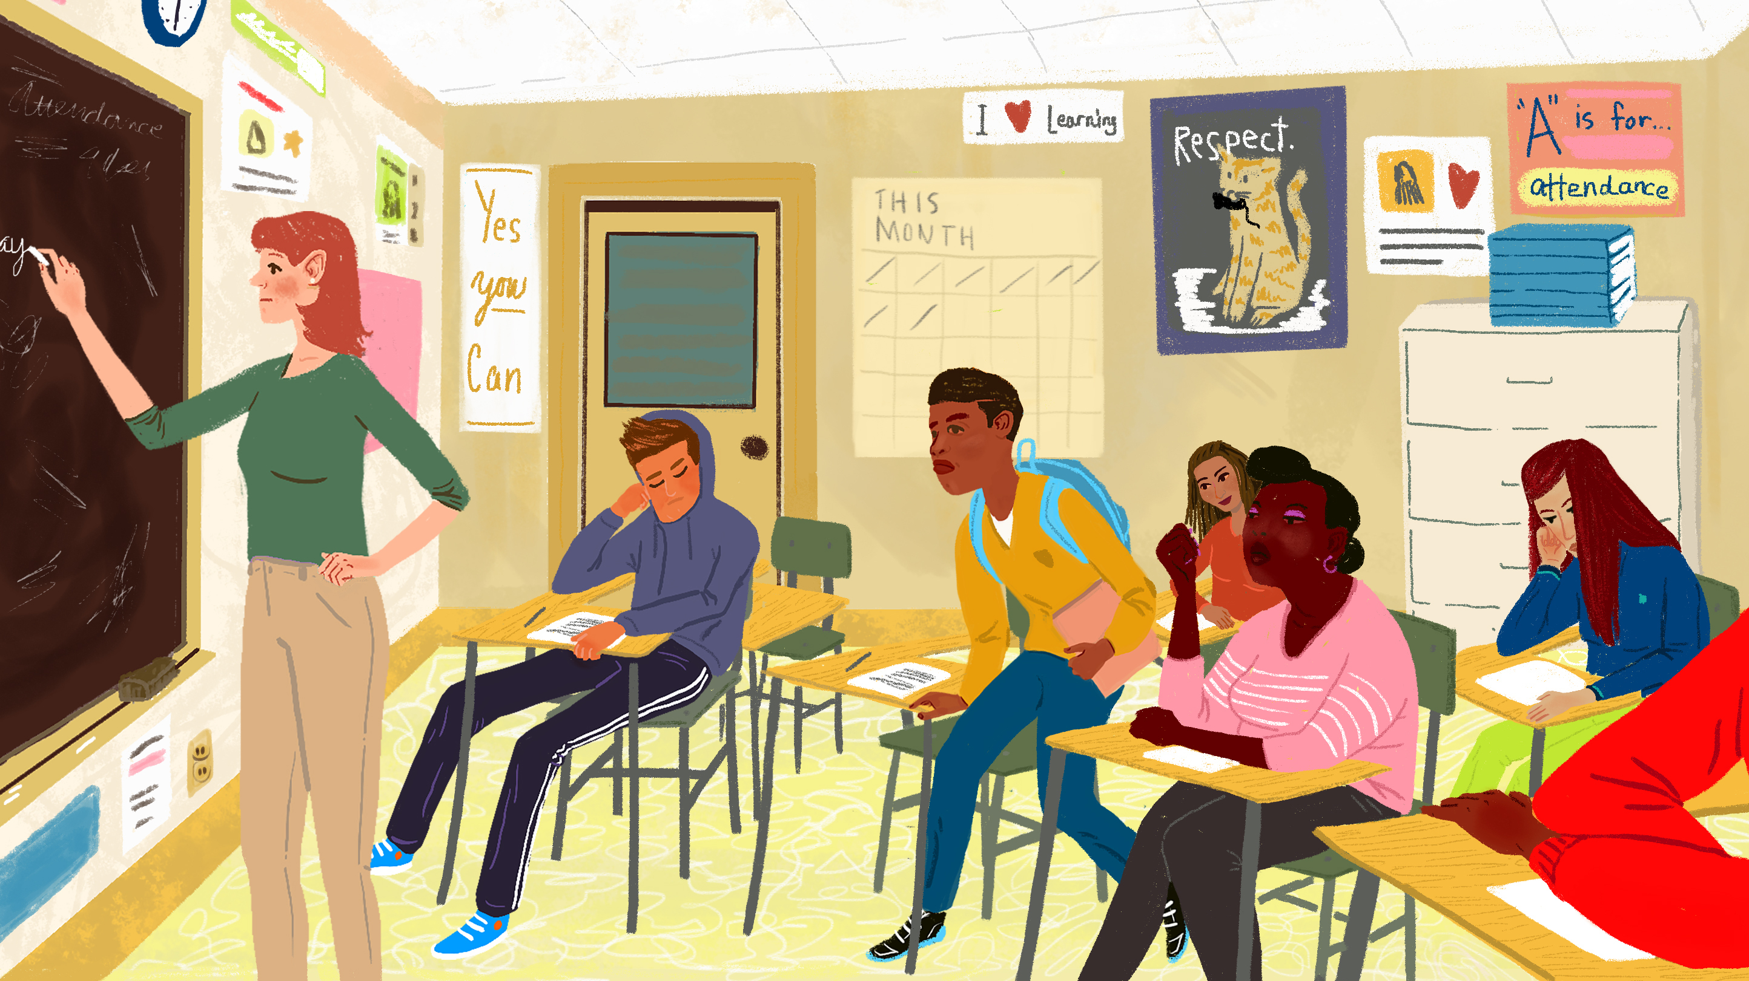
Attendance during the COVID Pandemic
How many students would attend ?
How many parents won’t let children go to school ?
How attendance affect unemployment?
How COVID make life change?

Slide 4
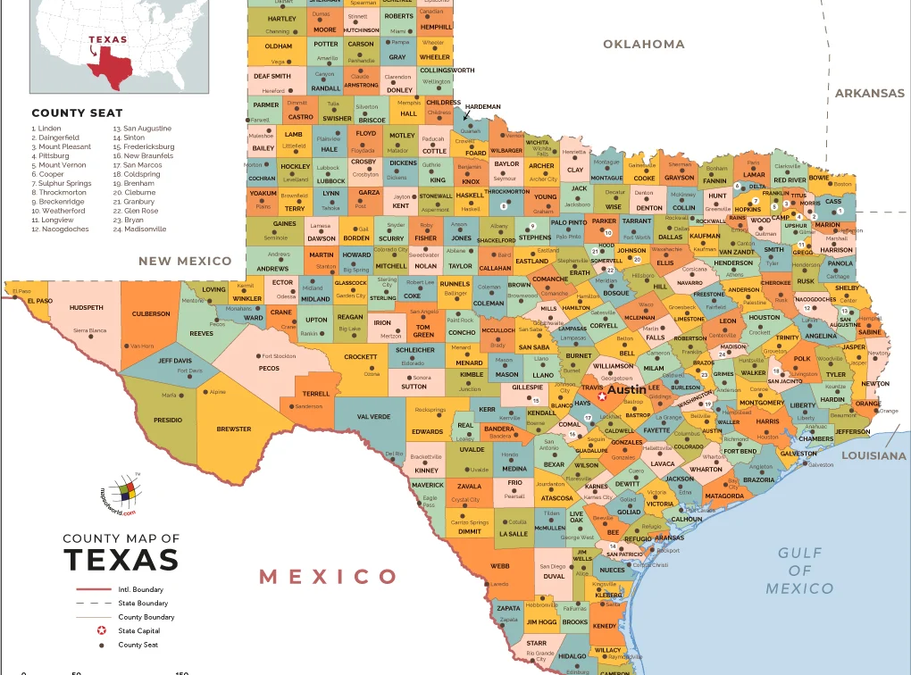
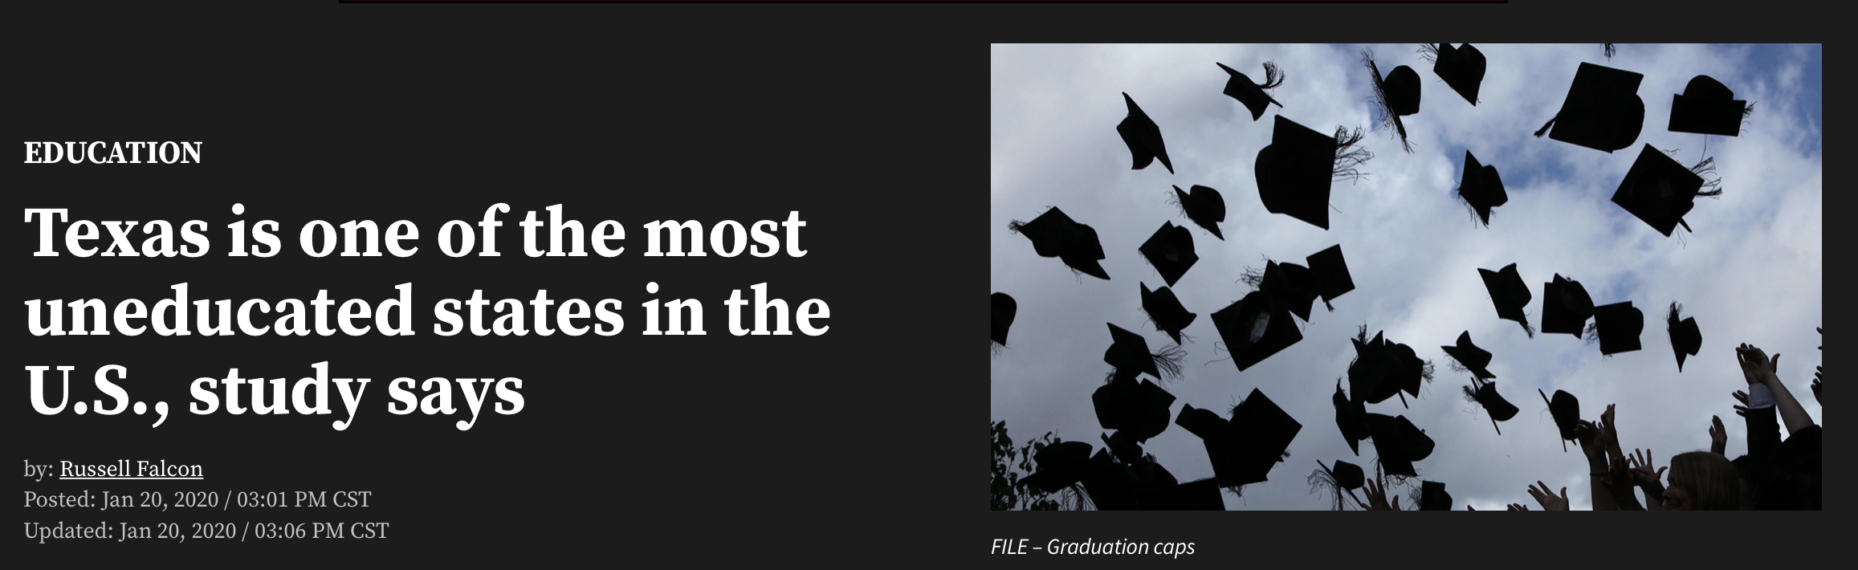
No. 39

Slide 5
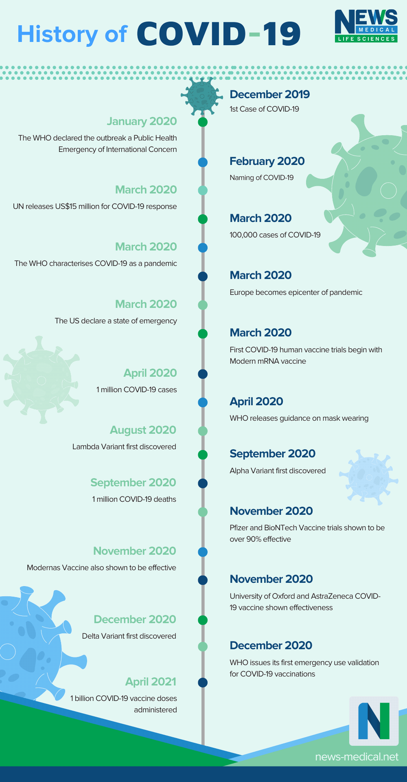

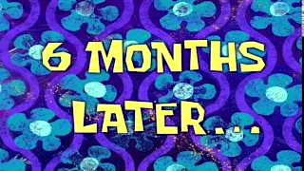
My Prediction
COVID
Attendance
Unemployment

Slide 6
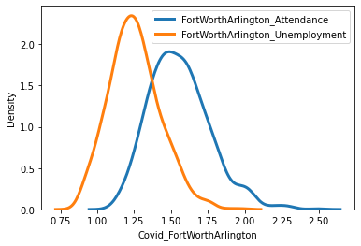
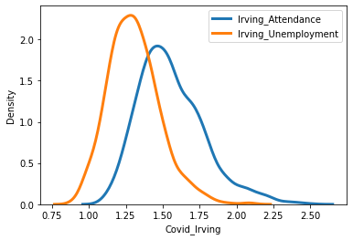
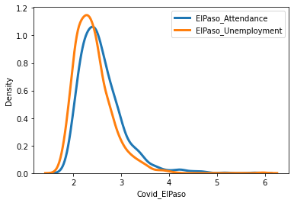
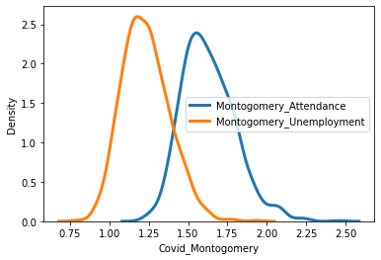
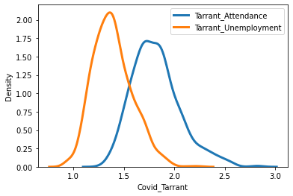
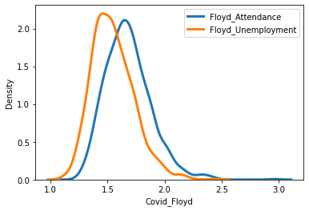
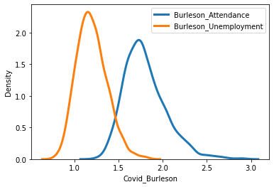
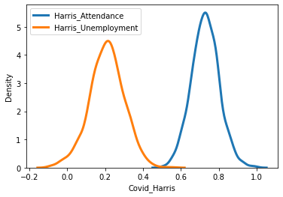
2 t- test
Almost overlapped in two distributions!
ElPaso has the most same distribution of the attendance and the unemployment with most broad distribution range.
Harris has the different distribution of the attendance and the unemployment with the narrowest distribution range.

Slide 7
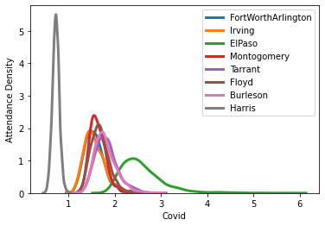
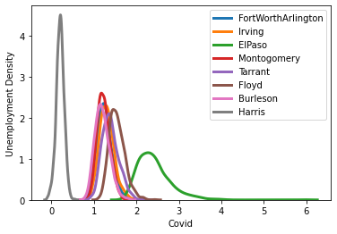
2 t- test with various counties
Attendance
Unemployment

Slide 8
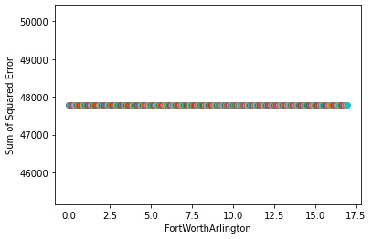
Linear regression
np.mean(attendance percentage)
County | Slope 1 (High Attendance) | Slope 2 (Unemployment) | Slope 3 (Relationship)
Fort Worth Arlington | 1.05 | -1.26 | -0.04
Irving | -1.04 | -2.10 | 0.06
El Paso | -6.15 | -1.43 | 0.66
Montogomery | 9.57 | -1.35 | -1.05
Tarrant | 4.10 | -1.32 | -0.50
Floyd | 8.40 | -1.62 | -0.92
Burleson | -0.17 | -1.65 | 0.03
Harris | 5.98 | -0.54 | -0.70
“Only one form with the straight horizontal line”

Slide 9
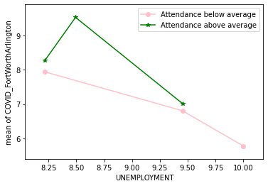
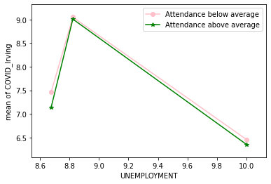
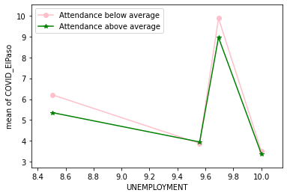
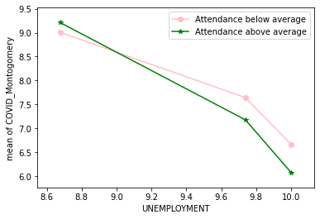
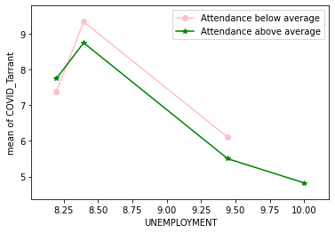
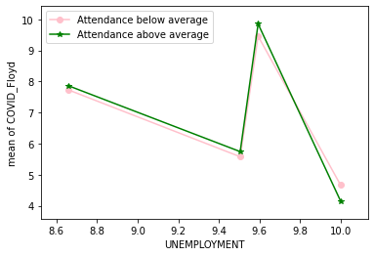
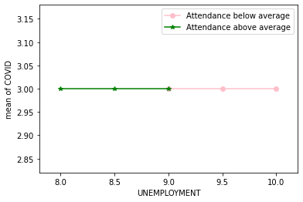
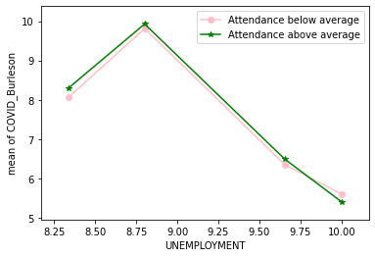
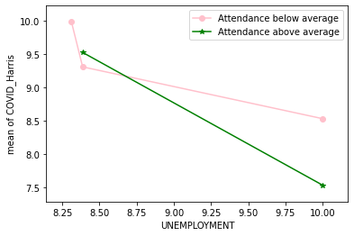
Relationship
According to the prediction, low attendance should be positioned in high unemployment range.

Slide 10
Conclusion
My Prediction with the relationship of Covid ~ Attendance was not exactly corrleated from the results of the relationship plots.
Attendance has NO relevant to the unemployment during the COVID pandemic.
In most counties, most unemployment decreased at the highest COVID cases, and the unemployment got increased at the last.

Slide 11
Limitations & Next Step
Due to the mandatory attendance, finding the attendance data sufficiently is not accessible and most student might attend the classes despite COVID.
Based on findings, I want to analyze the student behavior on the attendance during the pandemic and the consequence of school life such as grades or interpersonal relationship and the influence of school life on the home environment.

Slide 12
Thank you :)

